Slide 1
BIOMIMICRY
A bite-sized introduction
Lesson 5: Learning to Make Connections between Nature’s Abilities and Human Aspirations

Slide 2
What is an analogy?
'Tis but thy name that is my enemy;
Thou art thyself, though not a Montague.
What's Montague? It is nor hand, nor foot,
Nor arm, nor face, nor any other part
Belonging to a man. O, be some other name!
What's in a name? That which we call a rose
By any other name would smell as sweet…
William Shakespeare
Notes:
Discussion: How is this famous excerpt from Shakespeare’s play, Romeo and Juliet, an analogy? In the play, Juliet and Romeo are in love, however they come from warring families, and this creates difficulties for the would-be couple. Romeo is a Montague. In this selection, Juliet is speaking. Here, she makes an analogy between the superficiality of the name “rose” and the actual sweet smell of a rose, and the family name “Montague” and the actual lovability of Romeo. How does this analogy help what Juliet is feeling? We understand the logic that a rose smells sweet regardless of what it’s called, and understand that were a rose known by another name, it would be silly to think this changed how it smelled. By using analogy, Shakespeare quickly and powerfully communicates the absurdity of Romeo’s family name getting in the way of their relationship. Analogy can transfer ideas from one situation (what roses are called and how they smell) to another situation (complicated love between people).

Slide 3
What is an analogy?
…a bird that stalks
down his narrow cage
can seldom see through
his bars of rage
his wings are clipped and
his feet are tied
so he opens his throat to sing.
Maya Angelou
Notes:
Another example of analogy comes from Maya Angelou’s poem, Caged Bird:
…a bird that stalks
down his narrow cage
can seldom see through
his bars of rage
his wings are clipped and
his feet are tied
so he opens his throat to sing.
Throughout the poem a contrast is drawn with free birds. This selection describes several things about a caged bird, especially how the bird suffers from imprisonment, even if the bird isn’t fully aware of this suffering. Do we think Maya Angelou really wanted to write about birds, or is she making an analogy to something else? Why is it effective to make an analogy between caged birds and the much bigger topic of oppression of people? By making an analogy between a large and complex topic (the oppression of people) and a simple, easy-to-picture phenomenon like a caged bird, it makes it easier for the reader to think about and access their feelings about a bigger, more difficult topic.

Slide 4
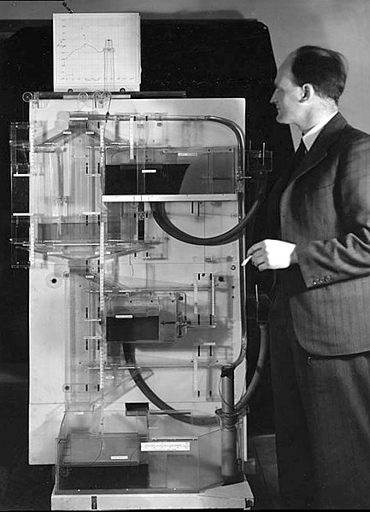
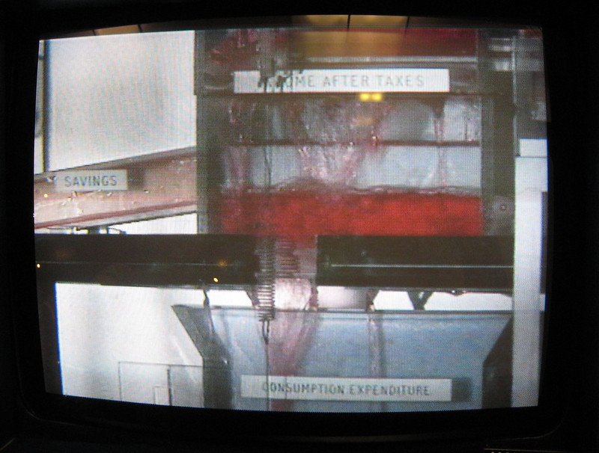
What is an analogy?
The MONIAC device (Monetary National Income Analogue Computer)
Paul Downey CC by 2.0
Notes:
Discussion: Another example of analogy comes from the MONIAC device. The MONIAC (Monetary National Income Analogue Computer) uses water flows to model the national economic dynamics of the U.K It was created in 1949 by New Zealand economist Bill Phillips. How does the device make an analogy? What are the advantages of explaining economics this way? The MONIAC makes an analogy between water flowing through a series of tanks and pipes and money flowing through the economy. The physical representation of the “flow” of money makes it easier to see how spending impacts the economy. Read more on the original MONIAC on Wikipedia: https://en.wikipedia.org/wiki/MONIAC
MONIAC photo: https://commons.wikimedia.org/wiki/File:Phillips_and_MONIAC_LSE.jpg
MONIAC detail: https://www.flickr.com/photos/psd/308091242

Slide 5
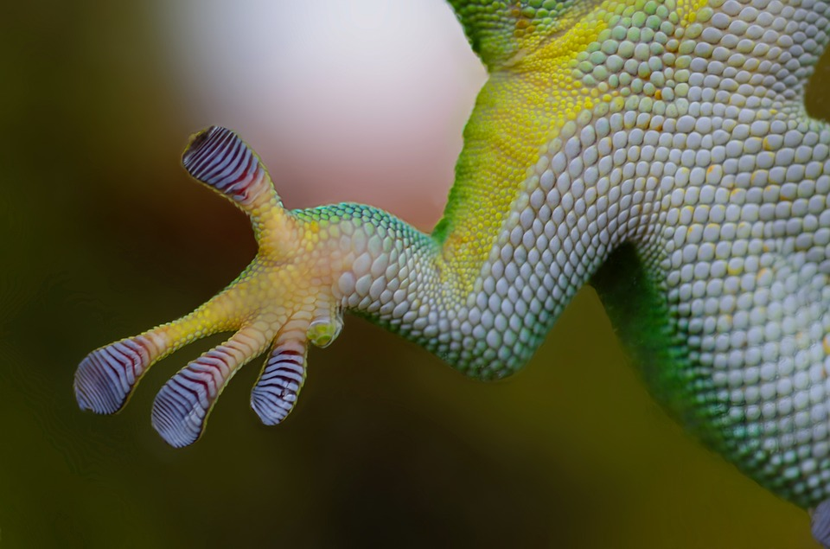
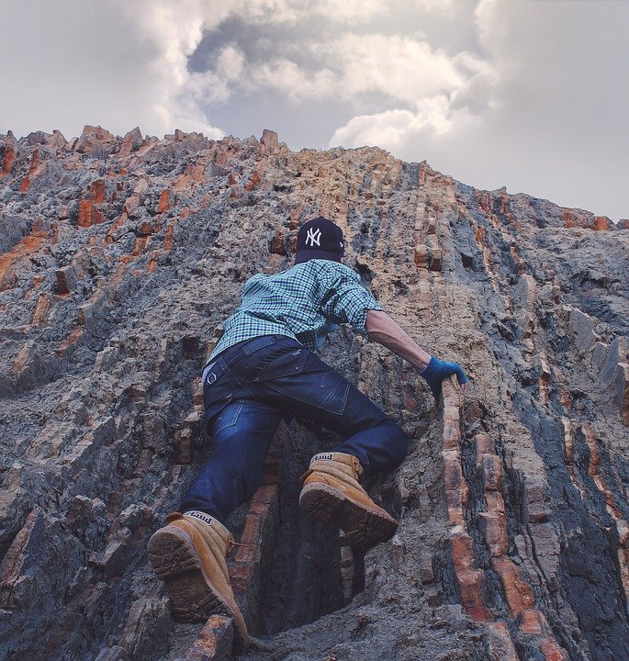
The role of analogies in biomimicry
Biomimics draw analogies between what nature can do (its abilities, or strategies) and what humans want to do (our technological needs and wants).
Notes:
What role does analogy play in biomimicry? Biomimics draw analogies between what nature can do (its abilities, or strategies) and what humans want to do (our technological needs and wants).
Discussion: How do biomimics use analogies in the examples of biomimicry we’ve learned about so far? Refer to examples of biomimicry that the class has learned about. Have students explain the analogies that were made by biomimics in each case. As one example, biologists drew an analogy between how geckos climb walls and how humans might be able to adhere to surfaces without glue.
Climbing: https://pixabay.com/photos/people-man-guy-climbing-mountain-2572126/
Gecko: https://pixabay.com/photos/gecko-hand-sticky-nature-reptile-800887/

